Slide 1

Operations Management: Unlocking Business Success
Welcome to the world of Operations Management (OM)! Explore how OM strategies and practices drive success in businesses like D-mart, and AMUL.

Slide 2

What is Operations Management (OM)?
OM is the strategic management of processes and resources that transform inputs into desired outputs. Learn how OM optimizes efficiency, quality, and customer satisfaction.

Slide 3

Objectives of OM
1
Efficiency
2
Quality
Maximize resource utilization and minimize costs to achieve operational excellence.
Deliver products and services that meet or exceed customer expectations.
3
Effectiveness
4
Lead time
Producing right kind of goods and services that satisfy the customers needs
Minimizing throughout time- the time that that elapses in the conversion process- by reducing delays, waiting time and idle time

Slide 4
Objectives of OM
5
Capacity Utilization
6
Cost
maximizing utilization of manpower, machines etc.
Minimizing cost of producing goods or rendering a service.

Slide 5
Scope of OM
OM covers a wide range of activities, including supply chain management, inventory control, production planning, and service delivery. It touches every aspect of a business's operations.
Plant location and facilities location
Plant Layout
Material Handling
Product Design
Process Design
Production Planning and Control
Quality Control
Materials Management
Maintenance Management

Slide 6
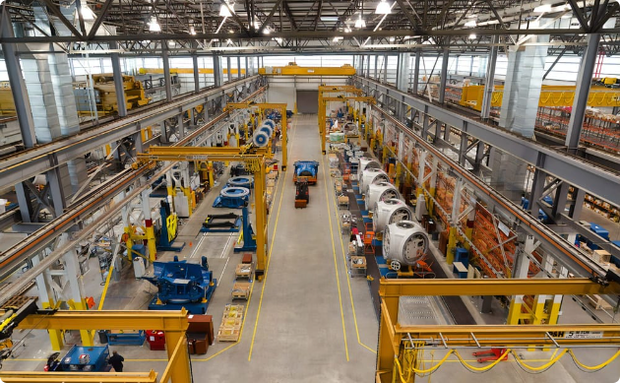

Applications in Product and Service Industry
Product Industry
Service Industry
OM ensures efficient production, quality control, and timely delivery of goods.
OM focuses on optimizing service processes, managing customer expectations, and delivering exceptional experiences.

Slide 7
Product Selection
Product Design
Selection of equipments and processes
Job Design
Facility Layout
Inventory Control
Production Control
Quality Control
Maintenance Management
Cost Control and improvement

Slide 8
Use of Competitive Advantage
Cost Leadership
Differentiation
Speed
Implement cost-efficient processes to offer competitive prices without compromising quality.
Create unique value propositions through innovative processes and customization.
Efficient and agile operations to meet customer demands faster than competitors.

Slide 9
Specified Product Selection
Faster Delivery
Cheaper Price
Better Quality
Customer Loyalty
Better Volume
Right Quantity
Timely Delivery
Creation of Goodwill
Branding
Increased Responsiveness
Increased Output
Growth of E-commerce.(e.g. Swiggy, Amazon)
Productivity is very important for nation
Every aspects of business is affected by its operations
Every organization need to streamline their activities eventually resulting maximum profit.

Slide 10
What Will You Learn in OM Specialization?
1
Strategic Planning
Learn to align operations with overall business strategy for sustainable growth.
Process Design and Improvement
2
Master the art of designing and optimizing operational processes.
3
Supply Chain Management
Understand how to manage the flow of goods and services throughout the supply chain effectively.

Slide 11
Career Path for MBA Operations
1
Entry-Level Roles
Join as an Operations Analyst or Management Trainee to gain hands-on experience in various operations functions.
2
Middle Management
Progress to roles like Operations Manager or Supply Chain Manager, overseeing larger teams and operational strategies.
3
Leadership Positions
Reach executive positions like Director of Operations or Chief Operations Officer, responsible for shaping strategic decisions.

Slide 12



Career Opportunities in Operations
Logistics and Supply Chain
Production and Manufacturing
Service Operations
Lead service delivery teams, optimizing processes to provide exceptional customer experiences.
Manage the efficient movement, storage, and distribution of goods.
Oversee the production process, ensuring quality, efficiency, and timely delivery.

Slide 13
Why MBA Operations?
Large corporations are always on the lookout for skilled professionals who can do operations management for them
OM equip you with skills used in current and future business trend
work in almost every field. Whether you want to join the banking world, get into finance, or ride the technological wave, this degree will help you get entry in almost any field.
Profit sustainability
Startups require skilled professionals who can manage operations for them. Thus, a lot of startups that started in the last decade are now ready to pay impressive salaries to MBAs in Operations
Efficient Operation
improve the efficiency of your business activities
You also get to be with your company’s end product and directly involved in making the product; not many specializations give you this chance.

Slide 14
Who should do MBA
in Operations?
knack for organizing things, making plans for seamless execution, and getting desired results.
how businesses manage their production at such a huge scale, how businesses analyze the requirements of the market, and how products meet the expectations of customers.
interested in the operations side of the business.
completed your graduation degree in operations management and you want to continue your education in the same field..

Slide 15
Required Skills for MBA in
Operations
Quick decision-making
data analysis
If you like Numbers, OPS is for you.
good communication skills

Slide 16
Young People Chase Money. Money is always A byproduct. Do what you love, and money will come to you.
The purpose of life is to live life to its fullest, So select Specialization which you love.
*********************************

